Slide 1
Project Demo
Omer Rastgar
Aqib khan

Slide 2
Need statement
A way to address transmission of diseases in hospitals, and other public places so that there is a 99.999% decrease in overall pathogen count hence leading to low risk for contagion.

Slide 3
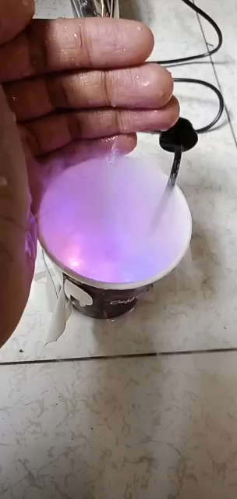
Ultra sound mist maker

Slide 4
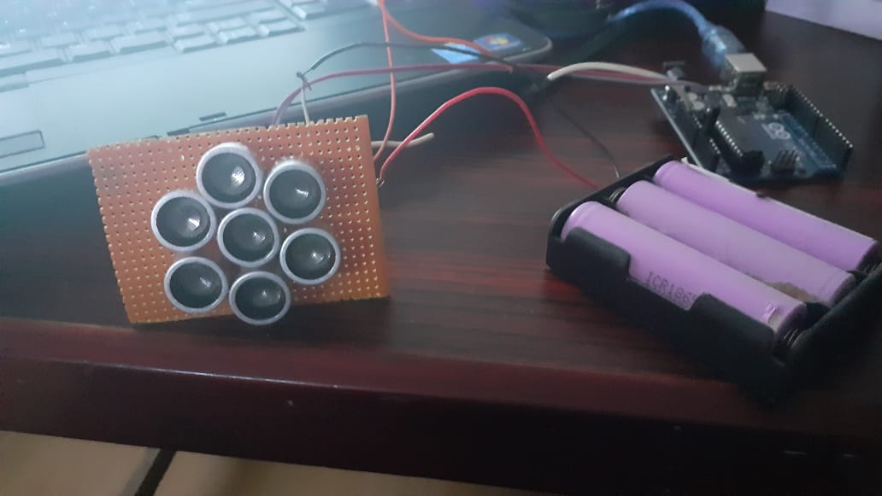
Ultra sound phased array

Slide 5
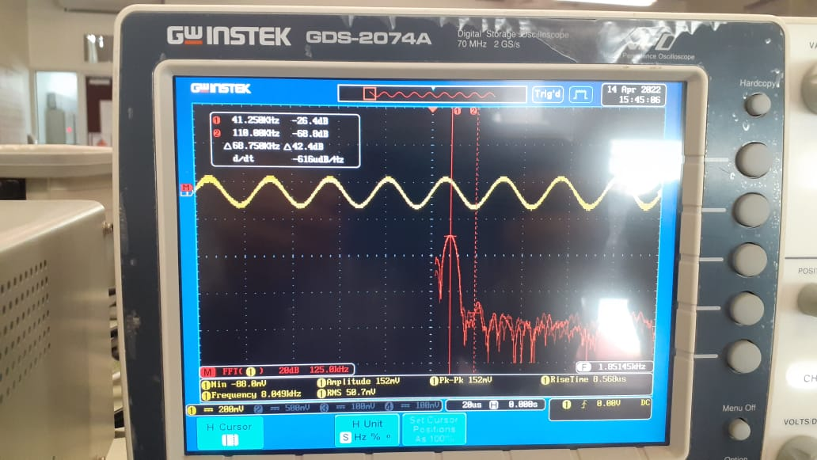
FFT test using receiver

Slide 6
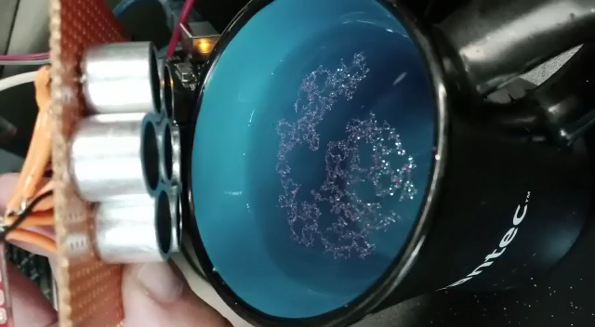
Effect of phased array ultra sound

Slide 7
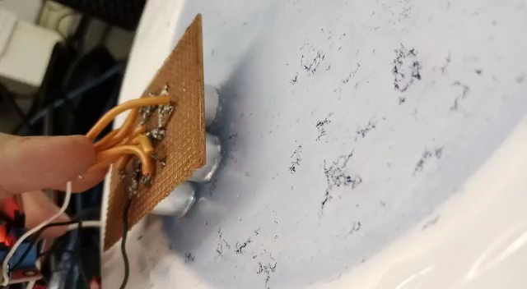
Effect of phased array ultra sound

Slide 8
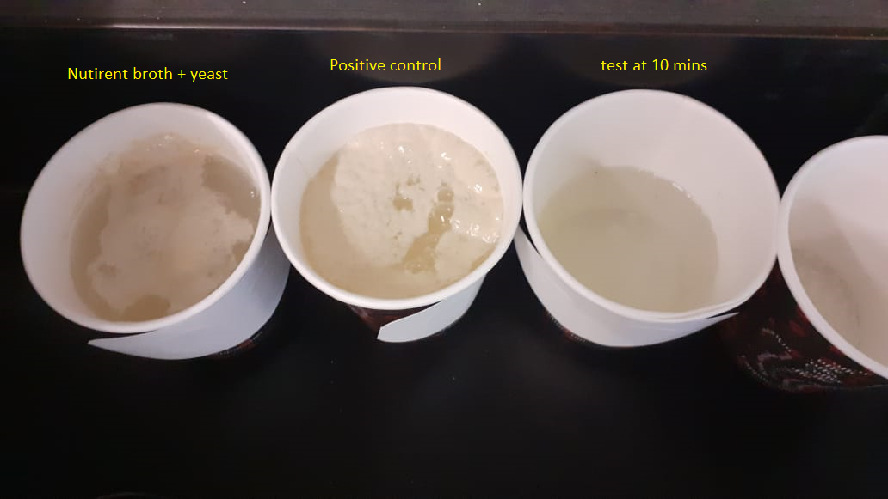
Testing efficacy with yeat solution

Slide 9
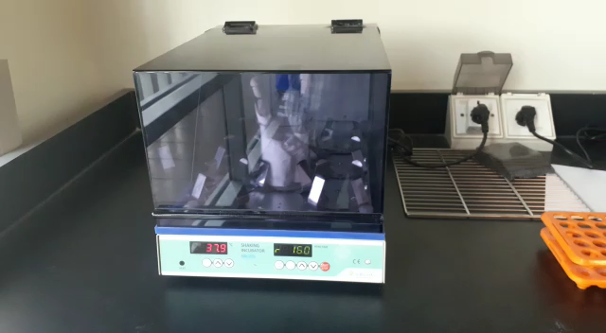
Bacteria test in biolab

Slide 10
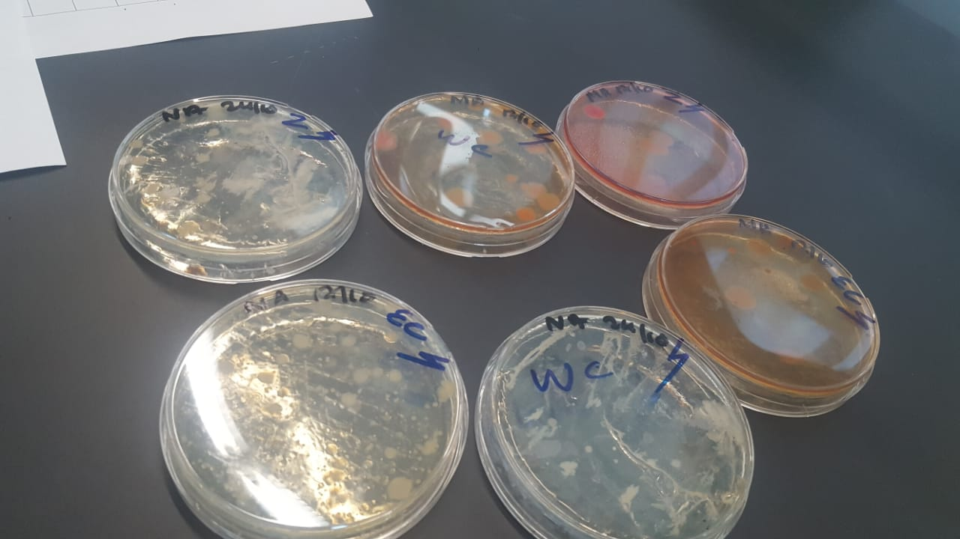
Bacteria test in biolab

Slide 11
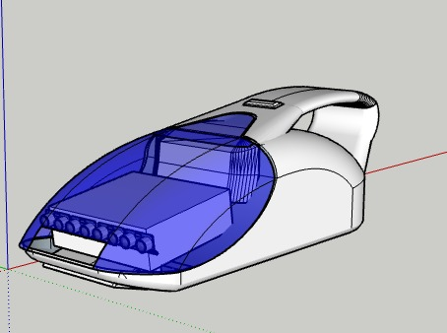
3D models

Slide 12
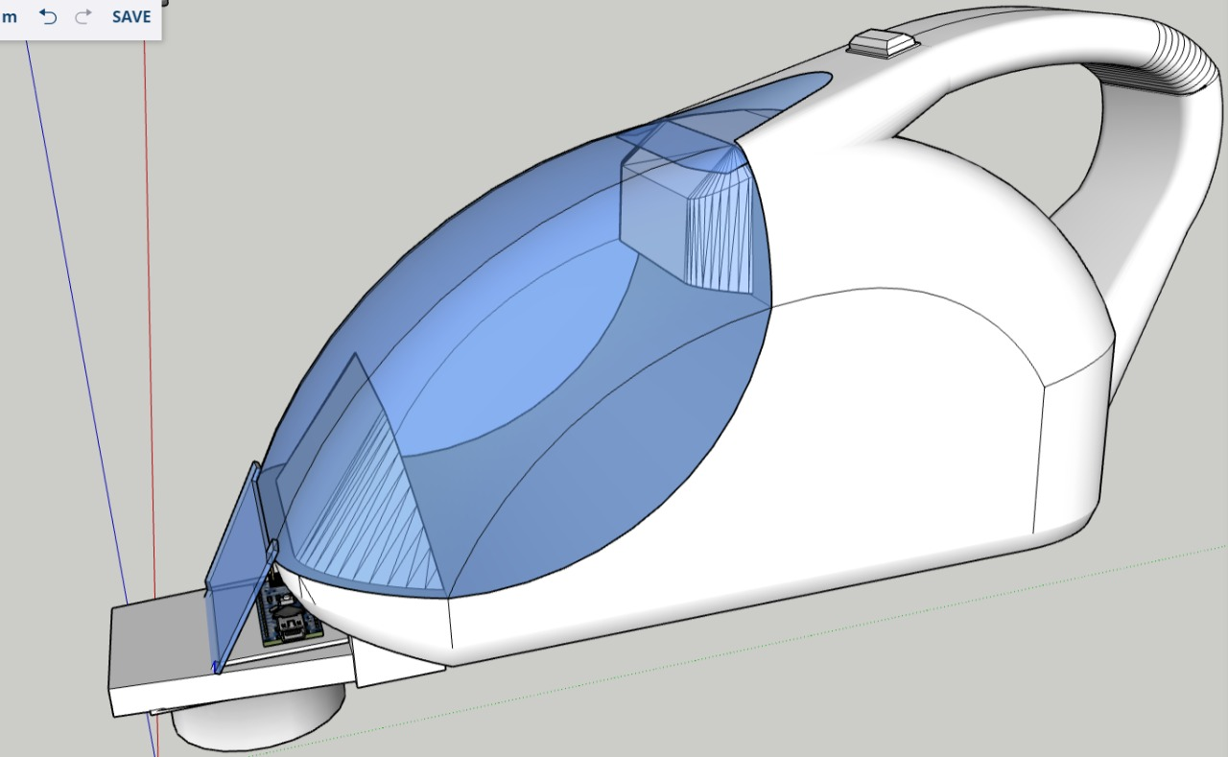
3D models

